Slide 1
Session 2: Is the Gaussian probability density function boring?
Looking good, Bayesian!
Histogram & Bayes Classifier (TWO DIMENSIONS)
Histogram & Bayes Classifier (TWO DIMENSIONS)
Histogram & Bayes Classifier (TWO DIMENSIONS)
Mean Vectors
Two Dimensional Data
Two Dimensional Data
Two Dimensional Data
Two Dimensional Gaussian Intuition
Two Dimensional Gaussian Intuition (more general)
What does an “outlier” mean?
How do I specify a 1D point cloud?
How do I specify a 2D point cloud?
How do I specify a 2D point cloud?
Covariance Interpretation Practice
Correlations between features
Covariance Matrix: Summary of correlations between features
Covariance: What does it measure?
Covariance versus variance
Covariance formula
Bayes Classifier (d DIMENSIONS)
Step-by-step: PDF of the binormal distribution
Calculation of the PDF of the binormal distribution
Calculation of the PDF of the multinormal distribution
Assignment 2 (unofficial)
Step-by-step: How can I build 2D Histograms?
Step-by-step: How can I build a 2D Bayesian Classifier?
Input and Output Panels
Matrix A
Understanding horizontal stretching
Vertical stretching
Tilt left and right
Parallel lines
Lines passing through the origin
Transformation of basis vectors
Basic vector-matrix multiplication
Arbitrary vector-matrix multiplication
General vector-matrix multiplication
Matrix-matrix multiplication
Determinant of a matrix
Inverse of a matrix
Standard binormal distribution and point cloud
Covariance matrix after linear transformation
Inverse image of given point 𝐱
Inverse image of square of unit area
What is the number of points enclosed?
Derivation of PDF of binormal distribution
Session 2 Summary

Slide 2

Looking good, Bayesian!
HP Autonomy’s headquarters in Cambridge, UK.

Slide 3
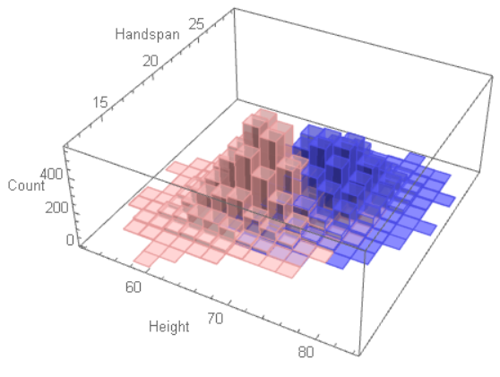


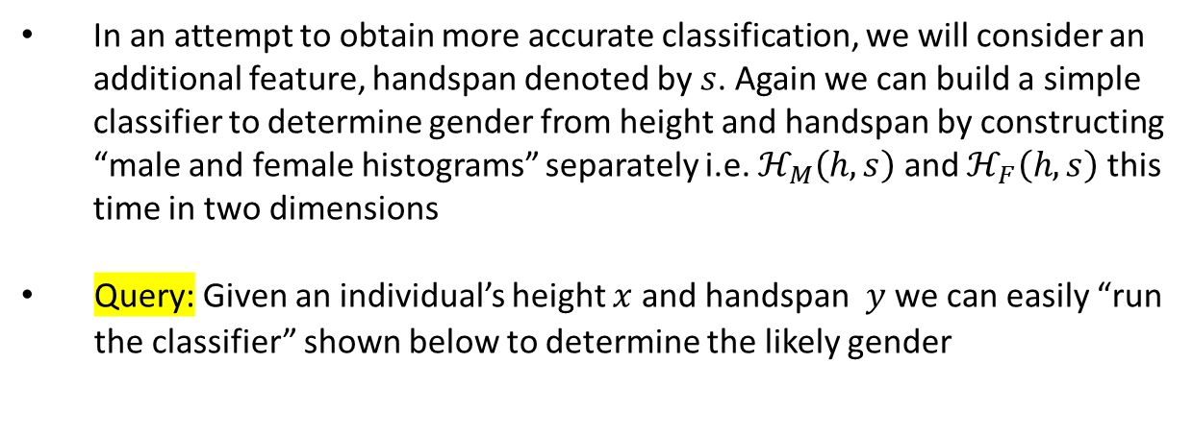
Histogram & Bayes Classifier (TWO DIMENSIONS)
In an attempt to obtain more accurate classification, we will consider an additional feature, handspan denoted by $s$. Again we can build a simple classifier to determine gender from height and handspan by constructing “male and female histograms” separately i.e. $ℋ_{M}\left(h,s\right)$ and $ℋ_{F}\left(h,s\right)$ this time in two dimensions
Query: Given an individual’s height $x$ and handspan $y$ we can easily “run the classifier” shown below to determine the likely gender
M
$$ℋ_{M}\left(x,y\right)$$
>
$$ℋ_{F}\left(x,y\right)$$
<
F
Think about the question: What formulas can we use to approximate the histograms?
Sandeep Gautham, you have been honored with the Eagle Eye Award for spotting errors on the previous slide.
Congratulations and thank you for your help in improving this presentation.
CLICK TO DISMISS

Slide 4
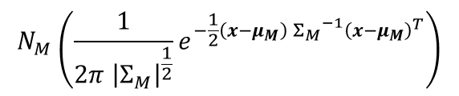
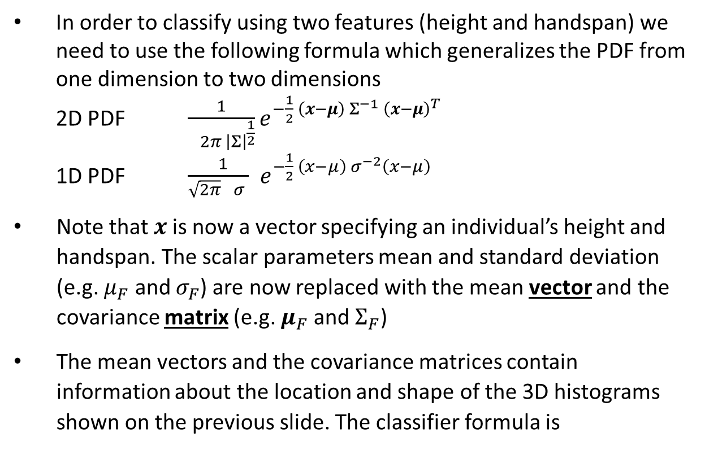
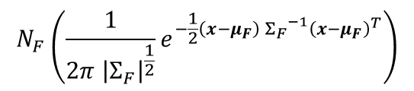
Histogram & Bayes Classifier (TWO DIMENSIONS)
In order to classify using two features (height and handspan) we need to use the following formula which generalizes the PDF from one dimension to two dimensions
2D PDF $\frac{1}{ 2π{ \left|Σ\right|}^{\frac{1}{2}}}e^{−\frac{1}{2} \left(x−μ\right) Σ^{−1} {\left(x−μ\right)}^{T}}$
1D PDF $\frac{ 1}{\sqrt{2π} σ }{ e}^{−\frac{1}{2} \left(x−μ\right){ σ}^{−2}\left(x−μ\right)}$
Note that $x$is now a vector specifying an individual’s height and handspan. The scalar parameters mean and standard deviation (e.g. $μ_{F}$ and $σ_{F}$) are now replaced with the mean vector and the covariance matrix (e.g. $μ_{F}$ and $Σ_{F}$)
The mean vectors and the covariance matrices contain information about the location and shape of the 3D histograms shown on the previous slide. The classifier formula is
$$N_{M}\left(\frac{1}{2π{ \left|Σ_{M}\right|}^{\frac{1}{2}}}e^{−\frac{1}{2}\left(x−μ_{M}\right) {Σ_{M}}^{−1}{\left(x−μ_{M}\right)}^{T}}\right)$$
M
$$N_{F}\left(\frac{1}{2π{ \left|Σ_{F}\right|}^{\frac{1}{2}}}e^{−\frac{1}{2}\left(x−μ_{F}\right) {Σ_{F}}^{−1}{\left(x−μ_{F}\right)}^{T}}\right)$$
>
<
F

Slide 5
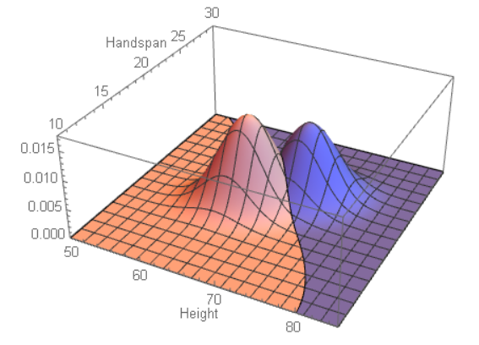
Histogram & Bayes Classifier (TWO DIMENSIONS)

Slide 6
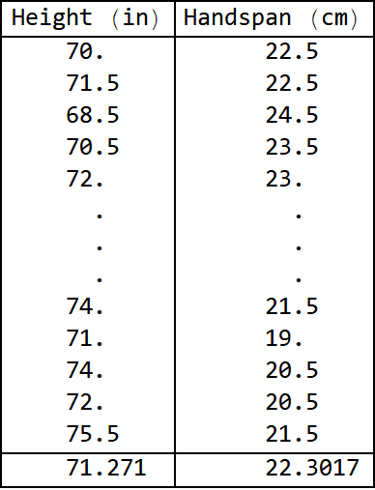
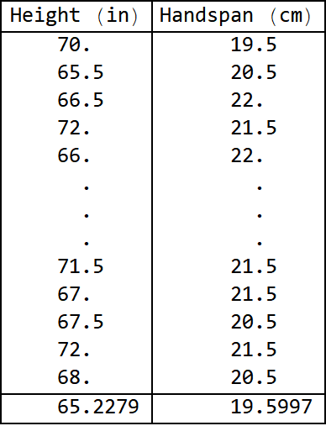
Mean Vectors
Male data (NM=7800)
Female data (NF=8900)
Male mean vector
Female mean vector

Slide 7
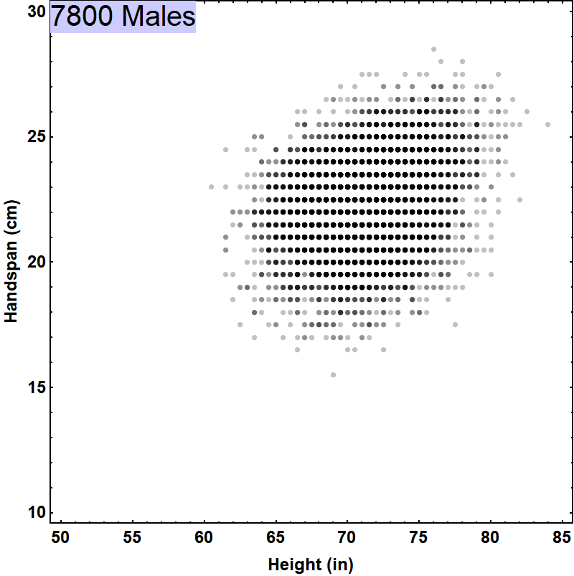
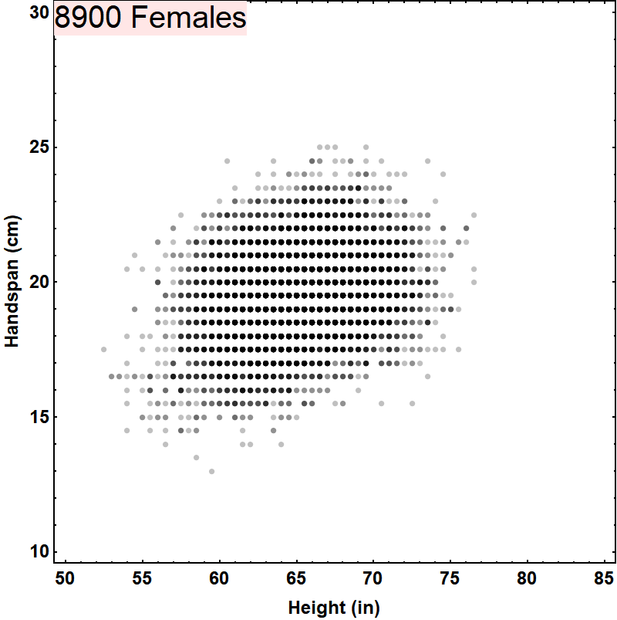
Two Dimensional Data

Slide 8
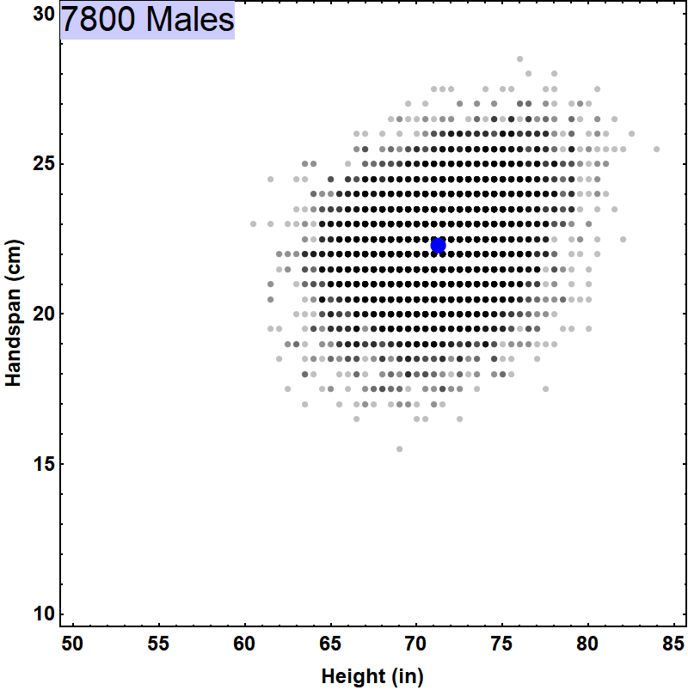
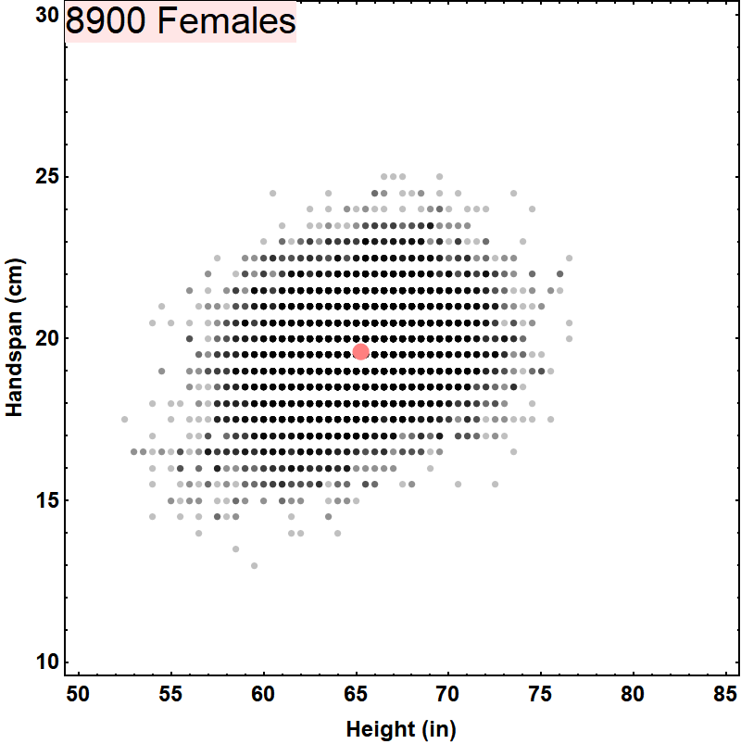
Two Dimensional Data
Male mean vector
Female mean vector
{71.271, 22.3017}
{65.2279, 19.5997}

Slide 9
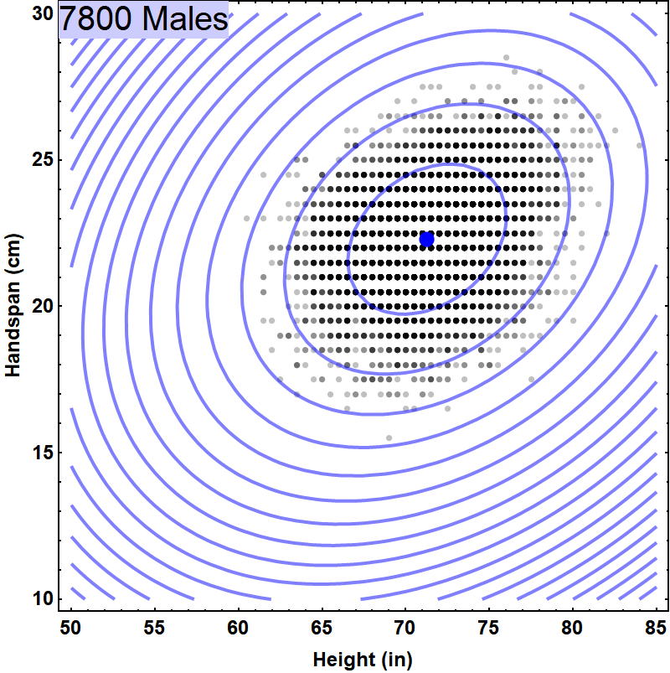
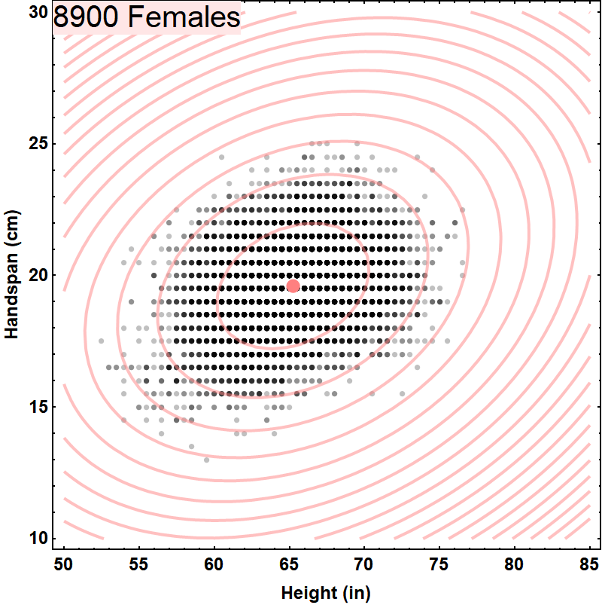
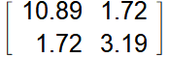
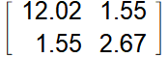
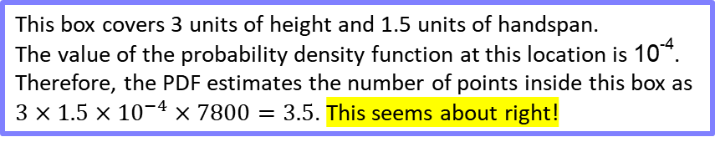
Two Dimensional Data
Male mean vector
Female mean vector
{71.271, 22.3017}
{65.2279, 19.5997}
10⁻²
10⁻²
10⁻³
10⁻⁴
10⁻³
10⁻⁴
Male Covariance Matrix
Female Covariance Matrix
This box covers 3 units of height and 1.5 units of handspan.
The value of the probability density function at this location is 10⁻⁴.
Therefore, the PDF estimates the number of points inside this box as
$3×1.5×{10}^{−4}×7800=3.5$. This seems about right!

Slide 10
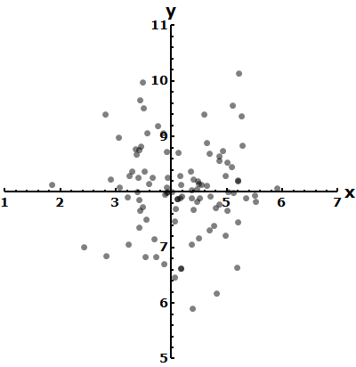
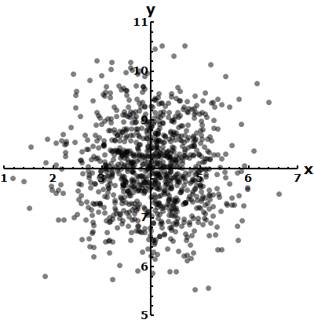
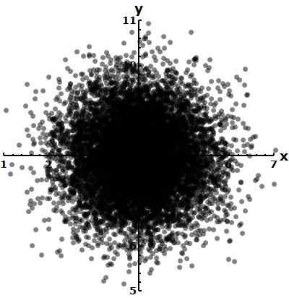
Two Dimensional Gaussian Intuition
Data generated by an unskilled marksman aiming for the point {4,8}. Good luck!
Some more tries …
Even more tries …
Errors are independent of orientation.
Errors in x are independent of errors in y.
Large errors are less probable

Slide 11
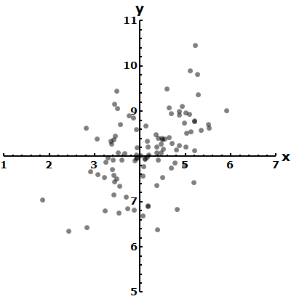
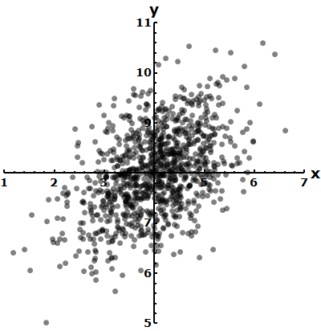
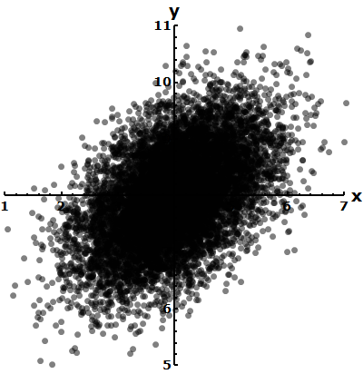
Two Dimensional Gaussian Intuition (more general)
Errors are dependent on orientation.
Errors in x are dependent on errors in y.
Large errors are less probable

Slide 12
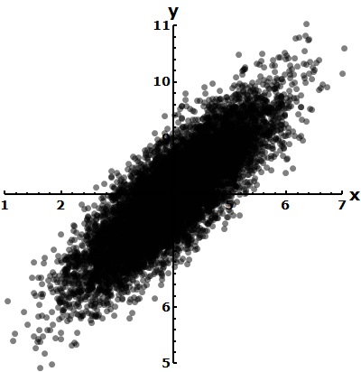
What does an “outlier” mean?
Not an outlier
Is an outlier

Slide 13
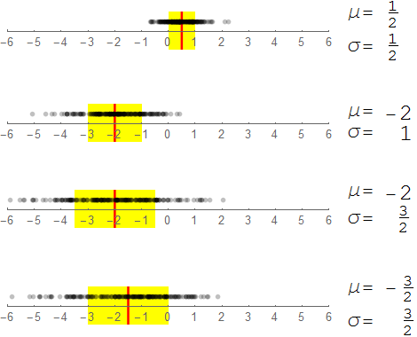
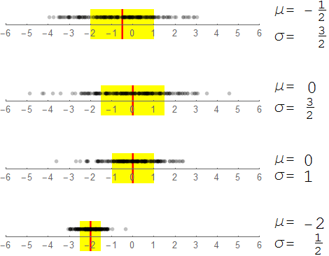
How do I specify a 1D point cloud?
The yellow band encloses 68% of the points

Slide 14
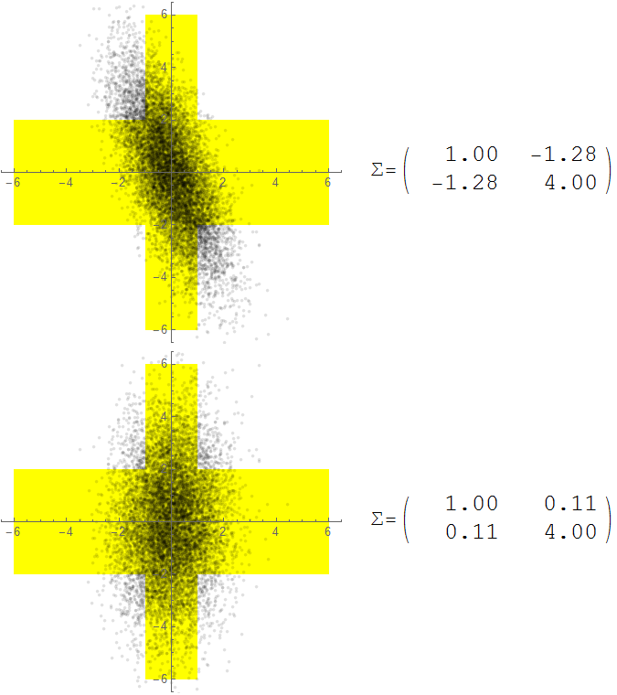
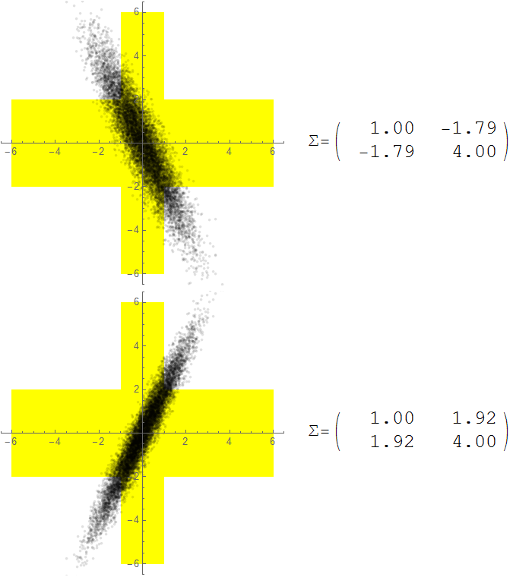
How do I specify a 2D point cloud?
This yellow band encloses 68% of the points
This yellow band encloses 68% of the y-coordinates
1
2
Variance in the horizontal direction
Variance in the vertical direction
3
4

Slide 15
How do I specify a 2D point cloud?
The standard deviations alone are NOT sufficiently descriptive.

Slide 16
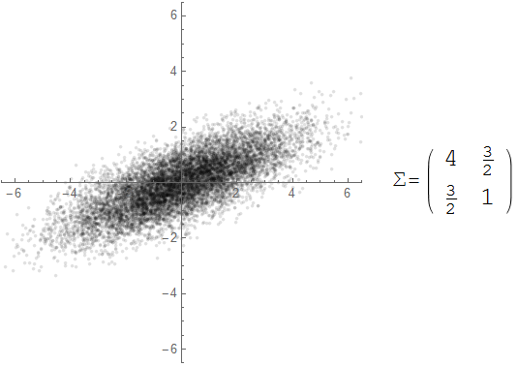
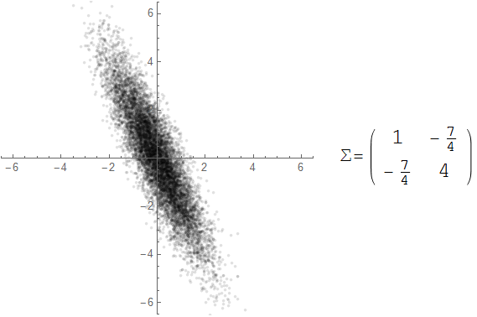
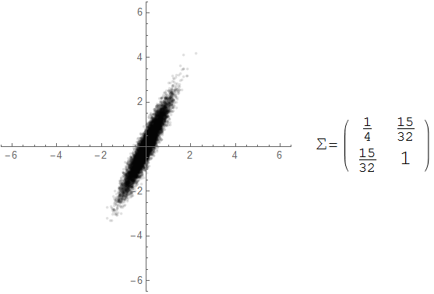
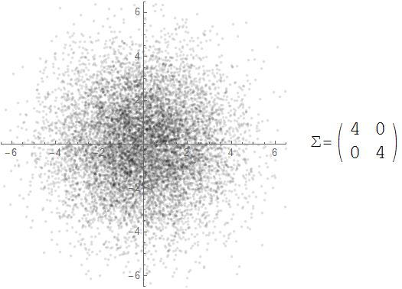
Covariance Interpretation Practice

Slide 17
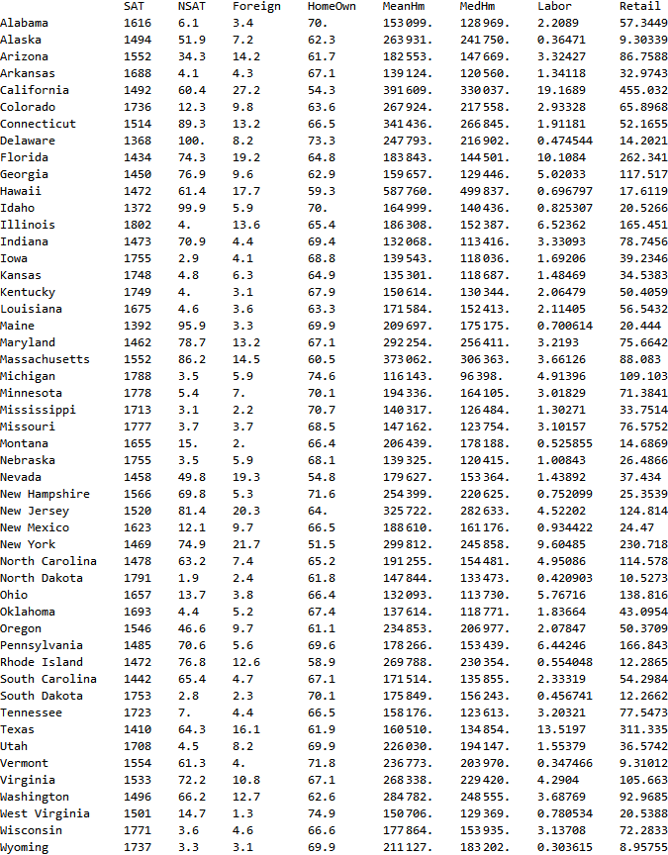
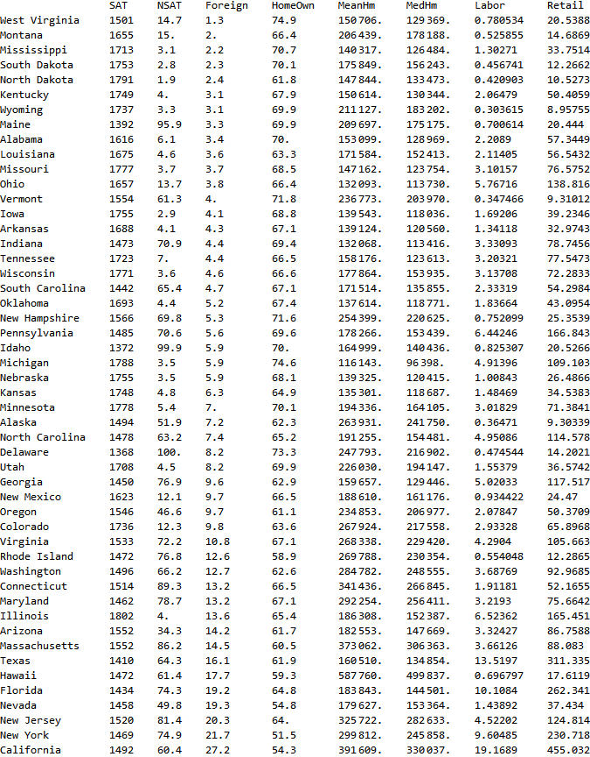
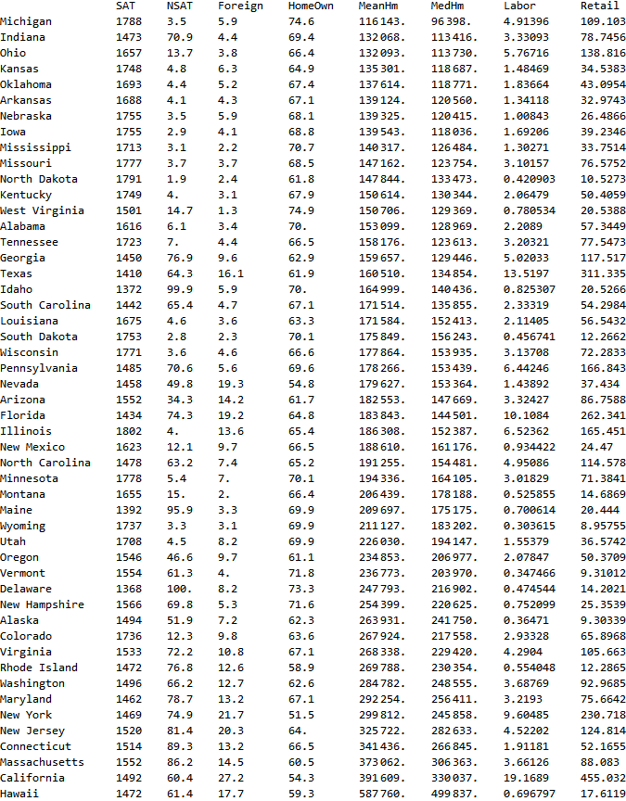
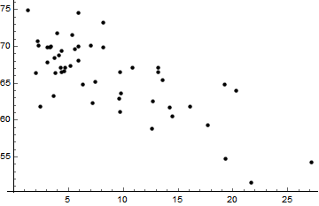
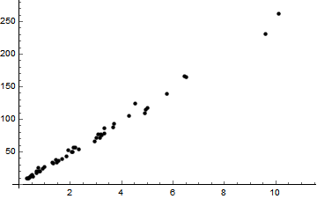
Correlations between features
Fraction Owning home
Fraction foreign-born
Median home price
Mean home price

Slide 18
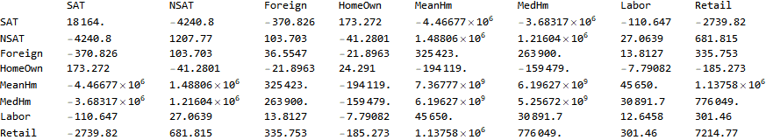
Covariance Matrix: Summary of correlations between features

Slide 19
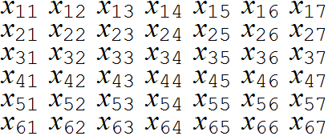
Covariance: What does it measure?
Features
Feature Vectors
N=6
d=7
Are the third and sixth features related?
Across the entire dataset, does one increase when the other increases?
On average, by what amount does the sixth feature increase or decrease when the third feature increases by 1 unit?

Slide 20
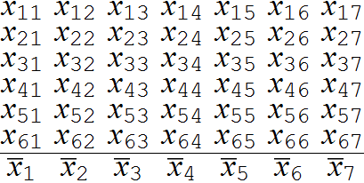
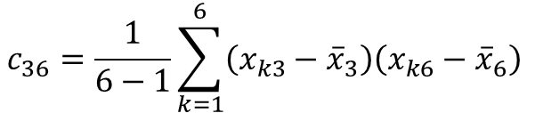
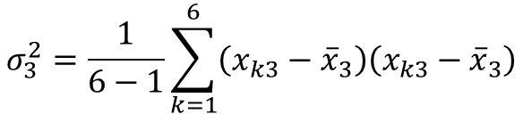
Covariance versus variance
Mean Vector
$$σ_{3}^{2}=\frac{1}{6−1}\sum_{k=1}^{6}{\left(x_{k3}−{\overline{x}}_{3}\right)\left(x_{k3}−{\overline{x}}_{3}\right)}$$
Variance of feature 3
$$c_{36}=\frac{1}{6−1}\sum_{k=1}^{6}{\left(x_{k3}−{\overline{x}}_{3}\right)\left(x_{k6}−{\overline{x}}_{6}\right) }$$
Covariance between features 3 & 6

Slide 21
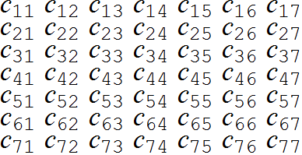
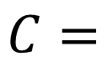
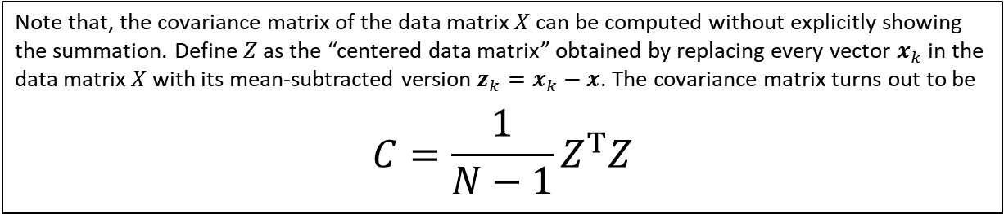
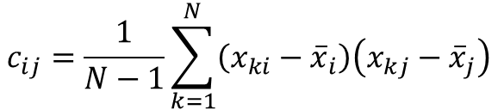
Covariance formula
$$c_{ij}=\frac{1}{N−1}\sum_{k=1}^{N}{\left(x_{ki}−{\overline{x}}_{i}\right)\left(x_{kj}−{\overline{x}}_{j}\right) }$$
$$C=$$
The covariance matrix has a number of special properties. Among them are:
Entries on the principal diagonal, being variances, must always be positive (see thin line)
Symmetrical entries (such as the two entries shown shaded) must be equal to one another
Note that, the covariance matrix of the data matrix $X$ can be computed without explicitly showing the summation. Define $Z$ as the “centered data matrix” obtained by replacing every vector $x_{k}$ in the data matrix $X$ with its mean-subtracted version ${z_{k}=x}_{k}−\overline{x}$. The covariance matrix turns out to be
$$C=\frac{1}{N−1}Z^{T}Z$$

Slide 22

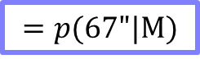
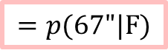
Bayes Classifier (d DIMENSIONS)
In order to classify using d features (height, handspan, voice frequency, … ) we need to use the following formula which contains a generalization of the normal PDFs
$$N_{M}\left(\frac{1}{{\left(2π\right)}^{\frac{d}{2}}{\left|Σ_{M}\right|}^{\frac{1}{2}}}e^{−\frac{1}{2}\left(x−μ_{M}\right) {Σ_{M}}^{−1}{\left(x−μ_{M}\right)}^{T}}\right)$$
M
$$N_{F}\left(\frac{1}{{\left(2π\right)}^{\frac{d}{2}}{\left|Σ_{F}\right|}^{\frac{1}{2}}}e^{−\frac{1}{2}\left(x−μ_{F}\right) {Σ_{F}}^{−1}{\left(x−μ_{F}\right)}^{T}}\right)$$
>
<
F
$$\left\{1×d\right\}$$
$$\left\{d×d\right\}$$
$$\left\{d×1\right\}$$
Turns out to be a scalar, real number
M
$$N_{M} 𝒩\left(x|μ_{M},Σ_{M}\right)$$
>
$$N_{F} 𝒩\left(x|μ_{F},Σ_{F}\right)$$
<
F

Slide 23
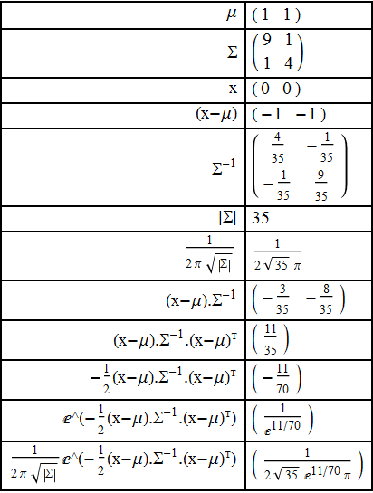
Step-by-step: PDF of the binormal distribution
It is highly recommended that you define a general function to compute the PDF of a Gaussian distribution in multiple dimensions. At least once, calculate an example by hand (the calculation of the inverse is optional) and track all the intermediate results

Slide 24

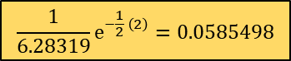






Calculation of the PDF of the binormal distribution
The PDF of a Gaussian distribution in $d$ dimensions is given by
$$\frac{1}{{\left(2π\right)}^{\frac{d}{2}}{\left|Σ\right|}^{\frac{1}{2}}}e^{−\frac{1}{2}\left(x−μ\right) Σ^{−1}{\left(x−μ\right)}^{T}}$$
If $x$ and $μ$ are two dimensional vectors and $Σ$ is a $2×2$ matrix, the expression for the PDF can be written in a form more suitable for computation by writing out the variables and parameters explicitly:
$$x=\left\{x_{1},x_{2}\right\} \text{and} μ=\left\{μ_{1},μ_{2}\right\}$$
$Σ=\left(\begin{matrix}c_{11} & c_{12} \\ c_{12} & c_{22}\end{matrix}\right)$ (note that due to the symmetry of the covariance matrix $c_{12}=c_{21}$
Before writing out the final expression for the PDF, a few intermediate quantities are need to be computed:
Define a new vector $z=\left\{z_{1},z_{2}\right\}=$ $\left\{x_{1}−μ_{1},x_{2}−μ_{2}\right\}$
Define $D$ as the determinant $\left|Σ\right|=c_{11}c_{22}−c_{12}^{2}$
Define matrix $A$ as the inverse of the covariance matrix $A=Σ^{−1}=\left(\begin{matrix}a_{11} & a_{12} \\ a_{12} & a_{22}\end{matrix}\right)=\left(\begin{matrix}\frac{c_{22}}{D} & −\frac{c_{12}}{D} \\ −\frac{c_{12}}{D} & \frac{c_{11}}{D}\end{matrix}\right)$
Now the PDF can be written easily computed as
$$\frac{1}{ 2π\sqrt{D}}e^{−\frac{1}{2} \left(a_{11}z_{1}^{2}+2a_{12}z_{1}z_{2}+a_{22}z_{2}^{2}\right)}$$
Click to see worked example.
$$x_{1}=61, { x}_{2}=21,{ μ}_{1}=60,{ μ}_{2}=20$$
$$Σ=\left(\begin{matrix}c_{11} & c_{12} \\ c_{12} & c_{22}\end{matrix}\right)=\left(\begin{matrix}5 & 2 \\ 2 & 1\end{matrix}\right)$$
$z=\left\{z_{1},z_{2}\right\}=$ $\left\{1,1\right\}$
$$\left|Σ\right|=1$$
$$A=\left(\begin{matrix}a_{11} & a_{12} \\ a_{12} & a_{22}\end{matrix}\right)=\left(\begin{matrix}1 & −2 \\ −2 & 5\end{matrix}\right)$$
$$\frac{1}{\text{6.28319}}e^{−\frac{1}{2} \left(2\right)}=\text{0.0585498}$$
Ankit Shah, you have been honored with the Eagle Eye Award for spotting errors on the previous slide.
Congratulations and thank you for your help in improving this presentation.
CLICK TO DISMISS
Next Slide

Slide 25









Calculation of the PDF of the multinormal distribution
The inverse ($d×d$) of the covariance matrix for a given numerical dataset ($N×d$) can be found using callable functions available in most numerical software development platforms.
For the simple case of a $2×2$ covariance matrix $\left[\begin{matrix}c_{11} & c_{12} \\ c_{21} & c_{22}\end{matrix}\right]$, the inverse is readily calculated as $\left[\begin{matrix}c_{22} & −c_{12} \\ {−c}_{21} & c_{11}\end{matrix}\right]/\left(c_{11}c_{22}−c_{12}c_{21}\right)$.
Click on any box inside this formula to get a description. Click on the same box again to dismiss.
The covariance matrix ($d×d$) for a given numerical dataset ($N×d$) can be found using callable functions available in most numerical software development platforms.
$$\frac{1}{{\left(2π\right)}^{\frac{d}{2}}\sqrt{\left|Σ\right|}}e^{−\frac{1}{2} \left(x−μ\right) Σ^{−1}{\left(x−μ\right)}^{T}}$$
For a given feature vector $x$the scalar quantity $\left(x−μ\right) Σ^{−1}{\left(x−μ\right)}^{T}$ can be found using matrix multiplication functions available in most numerical software development platforms.
Alternatively, by defining the $d$- dimensional vector $z=x−μ$ and the matrix ${A=Σ}^{−1}$, the equivalent scalar quantity $z A z^{T}$ is easily calculated as $\sum_{j=1}^{d}{\sum_{k=1}^{d}{z_{j}z_{k}a_{jk}}}$
The determinant of the covariance matrix can be found using callable functions available in most numerical software development platforms.
For the simple case of a $2×2$ covariance matrix $\left[\begin{matrix}c_{11} & c_{12} \\ c_{21} & c_{22}\end{matrix}\right]$, the determinant is readily calculated as $c_{11}c_{22}−c_{12}c_{21}$.
Next Slide

Slide 26
Assignment 2 (unofficial)
The dataset that you need is in one of the sheets of the Excel file attached. The other sheets contain shaded cells meant to be filled in by you. Examine the sheets carefully and understand what must be computed or described. Except for cutting and pasting your results in the specific cells provided, do not alter the spreadsheet in any other way. This is the only recognized means of submitting this assignment.
Construct separate 2D histograms for male and female heights. You decide on the number of bins to use, making sure there is sufficient resolution and bin-filling. Represent height in rows, and handspan in columns -- both in ascending order of magnitude of the feature. Do not use a built-in histogram program.
Find the parameters of two 2D Gaussian models for the 2 PDFs to describe the data. Let the first dimension represent height, and the second dimension represent handspan. You may use built-in functions to compute these parameters, but do not use a built-in function to compute the pdf.
Based on the histograms and Gaussian models, compute the likely gender (with probability) of individuals with measurements as given below (Height in inches, handspan in centimeters). What are your observations?
Height Handspan 69 17.5 66 22 70 21.5 69 23.5
Extra credit: Reconstruct a histogram using female model parameters that can be compared to the female histogram constructed in Part 2. Similarly, reconstruct a histogram using male model parameters.

Slide 27

Step-by-step: How can I build 2D Histograms?
Set the number of histogram bins using Sturges’s Rule 𝐵=$\left\lceil \left(\log_{2}{N}\right)+1\right\rceil$ or other considerations. E.g. B=15. Here, $N$ refers to the number of samples in Class F or Class M, assumed to be equal. For simplicity, you may use the same number of bins for both the features.
Assume that the data is given as $X=\left\{\left\{h_{0},s_{0}\right\},\left\{h_{1},s_{1}\right\},\left\{h_{2},s_{2}\right\},…,\left\{h_{N−1},s_{N−1}\right\}\right\}$ where the heights are $h_{i}$, the handspans are $s_{i}$ and the genders are given as $G=\left\{g_{0},g_{1},g_{2},g_{3},…,g_{N−1}\right\}$.
Construct separate 2D histograms for the two classes. One way to do this is to first initialize (with zeros) two matrices $H_{F}$ and $H_{M}$, each of size $B×B$. Next, compute the minimum and maximum of each of the features found in the training data (irrespective of class). Let us call these limits $h_{min}$, $h_{max}$, $s_{min}$, and $s_{max}$. The matrices $H_{F}$ and $H_{M}$ will now be subjected to a sequence of updating operations till the histograms are built up.
For every feature vector $\left\{h_{i},s_{i}\right\}$ pair belonging to the training set, do:
Transform $\left\{h_{i},s_{i}\right\}$ to row-column indices $\left\{r,c \right\}$ using
$r=ROUND\left((B−1)\left(\frac{h_{i}−h_{min}}{h_{max}−h_{min}}\right)\right)$
$c=ROUND\left((B−1)\left(\frac{s_{i}−s_{min}}{s_{max}−s_{min}}\right)\right)$
If gender $g_{i}=F$, update $H_{F}$ as $H_{F}\left[r,c\right]=H_{F}\left[r,c\right]+1$. Otherwise, update $H_{M}$ as $H_{M}\left[r,c\right]=H_{M}\left[r,c\right]+1$.

Slide 28

Step-by-step: How can I build a 2D Bayesian Classifier?
Separate the data into male and female subsets
Find the mean vector and the covariance matrix separately for males and females. You may use a built-in function to compute these parameters.
For each requested query (height-handspan vector $x=\left\{h,s\right\}$) compute the posterior probabilities
$$p\left(F|x\right)=\frac{N_{F}\left(\frac{1}{2π{ \left|Σ_{F}\right|}^{\frac{1}{2}}}e^{−\frac{1}{2}\left(x−μ_{F}\right) {Σ_{F}}^{−1}{\left(x−μ_{F}\right)}^{T}}\right)}{\left(N_{M}\left(\frac{1}{2π{ \left|Σ_{M}\right|}^{\frac{1}{2}}}e^{−\frac{1}{2}\left(x−μ_{M}\right) {Σ_{M}}^{−1}{\left(x−μ_{M}\right)}^{T}}\right)\right)+\left(N_{F}\left(\frac{1}{2π{ \left|Σ_{F}\right|}^{\frac{1}{2}}}e^{−\frac{1}{2}\left(x−μ_{F}\right) {Σ_{F}}^{−1}{\left(x−μ_{F}\right)}^{T}}\right)\right)}$$
$$p\left(M|x\right)=\frac{N_{M}\left(\frac{1}{2π{ \left|Σ_{M}\right|}^{\frac{1}{2}}}e^{−\frac{1}{2}\left(x−μ_{M}\right) {Σ_{M}}^{−1}{\left(x−μ_{M}\right)}^{T}}\right)}{\left(N_{M}\left(\frac{1}{2π{ \left|Σ_{M}\right|}^{\frac{1}{2}}}e^{−\frac{1}{2}\left(x−μ_{M}\right) {Σ_{M}}^{−1}{\left(x−μ_{M}\right)}^{T}}\right)\right)+\left(N_{F}\left(\frac{1}{2π{ \left|Σ_{F}\right|}^{\frac{1}{2}}}e^{−\frac{1}{2}\left(x−μ_{F}\right) {Σ_{F}}^{−1}{\left(x−μ_{F}\right)}^{T}}\right)\right)}$$
See “Calculation of the PDF of the binormal distribution” for hints on computing the shaded quantities.
Perform classification by comparing $p\left(F|x\right)$ and $p\left(M|x\right)$.

Slide 29

Input and Output Panels
Bookmarks
Draw curve
Draw stick figure

Slide 30

Matrix A
Bookmarks
Change matrix

Slide 31

Understanding horizontal stretching

Slide 32
Vertical stretching
Bookmarks
Restore matrix
Change matrix

Slide 33

Tilt left and right
Bookmarks
Tilt right
Tilt left

Slide 34

Parallel lines
Bookmarks
Parallel Lines
Parallel Lines
Parallel Lines

Slide 35

Lines passing through the origin
Bookmarks
Line
Line
Line

Slide 36





Transformation of basis vectors
$$\left[0,1\right]$$
Second basis vector
$$\left[−1,3\right]$$
$$\left[1,2\right]$$
$$\left[1,0\right]$$
First basis vector

Slide 37






Basic vector-matrix multiplication
$$\left[0,1\right]$$
Second basis vector
$$\left[−1,3\right]$$
$$\left[1,2\right]$$
$$\left[1,0\right]$$
First basis vector
Vector
X
Matrix
=
Vector
$$\left[1,0\right]\left[\begin{matrix} 1 & 2 \\ −1 & 3\end{matrix}\right]= [1,2]$$
$$\left[0,1\right]\left[\begin{matrix} 1 & 2 \\ −1 & 3\end{matrix}\right]=[−1,3]$$

Slide 38
























Arbitrary vector-matrix multiplication
Given vector
$$\left[−1,1\right]$$
Second component$=1$
$$\left[−1,3\right]$$
$$\left[1,2\right]$$
$$\left[−2,1\right]$$
First component$=−1$
Given vector
$$=$$
First Component of given vector
$$×$$
First Basis Vector
$$+$$
Second Component of given vector
$$×$$
Second Basis Vector
$$\left[−1,1\right]$$
$$=$$
$$\left(−1\right)$$
$$×$$
$$\left[1,0\right]$$
$$+$$
$$\left(1\right)$$
$$×$$
$$\left[0,1\right]$$
Transformed vector
$$=$$
First Component of given vector
$$×$$
Transformed
First Basis Vector
$$+$$
Second Component of given vector
$$×$$
Transformed
Second Basis Vector
$$\left[−2,1\right]$$
$$=$$
$$\left(−1\right)$$
$$×$$
$$\left[1,2\right]$$
$$+$$
$$\left(1\right)$$
$$×$$
$$\left[−1,3\right]$$

Slide 39



















General vector-matrix multiplication
Given vector
$$\left[0,1\right]$$
Second basis vector
Transformed
Second Basis Vector
$$x=\left[x_{1},x_{2}\right]$$
Transformed
First Basis Vector
Second component$=$ $x_{2}$
$$\left[a_{21},a_{22}\right]$$
$$\left[a_{11},a_{12}\right]$$
$$\begin{matrix}a_{11} & a_{12} \\ a_{21} & a_{22}\end{matrix}$$
First component$=x_{1}$
$$\left[1,0\right]$$
First basis vector
$$y=\left[a_{11}x_{1}+a_{21}x_{2}, a_{12}x_{1}+a_{22}x_{2} \right]$$
$$y=x A$$
Given vector
$$=$$
First Component of given vector
$$×$$
First Basis Vector
$$+$$
Second Component of given vector
$$×$$
Second Basis Vector
$$\left[x_{1},x_{2}\right]$$
$$=$$
$$\left(x_{1}\right)$$
$$×$$
$$\left[1,0\right]$$
$$+$$
$$\left(x_{2}\right)$$
$$×$$
$$\left[0,1\right]$$
Transformed vector
$$=$$
First Component of given vector
$$×$$
Transformed
First Basis Vector
$$+$$
Second Component of given vector
$$×$$
Transformed
Second Basis Vector
$$\left[a_{11}x_{1}+a_{21}x_{2}, a_{12}x_{1}+a_{22}x_{2} \right]$$
$$=$$
$$\left(x_{1}\right)$$
$$×$$
$$\left[a_{11},a_{12}\right]$$
$$+$$
$$\left(x_{2}\right)$$
$$×$$
$$\left[a_{21},a_{22}\right]$$

Slide 40






Matrix-matrix multiplication
?
X
=
Matrix
Matrix
X
Matrix
=
Vector
Vector
Matrix
$$\left[\begin{matrix} 1 & 2 \\ −1 & 3\end{matrix}\right]\left[\begin{matrix}1 & 2 \\ 1 & 3\end{matrix}\right]=\left[\begin{matrix}3 & 8 \\ 2 & 7\end{matrix}\right]$$

Slide 41








Determinant of a matrix
The determinant of a matrix is the area of the image of the unit square
Area=1
Area=4
Area=4
Area=2
Area=-6
Area=-6
Area=0

Slide 42


Inverse of a matrix
The inverse of a matrix reverses the transformation applied to any vector.

Slide 43

Standard binormal distribution and point cloud
Normally distributed random points with each co-ordinate having mean 0 and standard deviation 1
The density at the point $x=\left[\begin{matrix}x_{1} & x_{2}\end{matrix}\right]$ is
$$\left(\frac{1}{\sqrt{2π}}e^{−\frac{1}{2}x_{1}^{2}}\right)\left(\frac{1}{\sqrt{2π}}e^{−\frac{1}{2}x_{2}^{2}}\right)$$
This can also be written as
$$\frac{1}{2π}e^{−\frac{1}{2} x{ x}^{T}}$$
$$x=\left[\begin{matrix}x_{1} & x_{2}\end{matrix}\right]$$

Slide 44

Covariance matrix after linear transformation
The covariance matrix of this distribution is the identity matrix
What is the covariance matrix of this distribution?
Answer: Covariance matrix ${Σ=A}^{T}$A
The covariance matrix before transformation is $\frac{1}{N−1} X^{T} X= I$ (Identity matrix). The covariance matrix after transformation by the matrix $A$ is$\frac{1}{N−1} {\left(XA\right)}^{T} \left(XA\right)=\frac{1}{N−1} A^{T} X^{T}X A=A^{T}$A

Slide 45

Inverse image of given point $x$
$x{ A}^{−1}$ (Inverse image)
$x$(Given point)

Slide 46

Inverse image of square of unit area
Parallelogram of area $\left(\frac{1}{\left|A\right|}\right)$
Square of unit area
The number of points inside the square equals the number of points inside the parallelogram

Slide 47
What is the number of points enclosed?
Parallelogram of area $\left(\frac{1}{\left|A\right|}\right)$
Square of unit area
Number of points inside parallelogram
=
Number of points inside square
Total number of points
Area of parallelogram
Density at point $x{ A}^{−1}$
Total number of points
Area of
square
Density at point $x$
$$×$$
$$×$$
$$×$$
$$×$$
N
$$\left(\frac{1}{\left|A\right|}\right)$$
$$\frac{1}{2π}e^{−\frac{1}{2} \left(x{ A}^{−1}\right){\left(x{ A}^{−1}\right)}^{T}}$$
N
$$1$$
$$PDF$$
$$×$$
$$×$$
$$×$$
$$×$$

Slide 48
Derivation of PDF of binormal distribution
PDF
$$=\frac{1}{2π\left|A\right|}e^{−\frac{1}{2} \left(x{ A}^{−1}\right){\left(x{ A}^{−1}\right)}^{T}}$$
$$=\frac{1}{2π\sqrt{\left|Σ\right|}}e^{−\frac{1}{2}\left(x{ A}^{−1}\right){\left(A^{−1}\right)}^{T}x^{T}}$$
$$=\frac{1}{2π\sqrt{\left|Σ\right|}}e^{−\frac{1}{2}\left(x{ A}^{−1}\right){\left(A^{T}\right)}^{−1}x^{T}}$$
$$=\frac{1}{2π\sqrt{\left|Σ\right|}}e^{−\frac{1}{2} x {\left(A^{T}A\right)}^{−1}x^{T}}$$
$$=\frac{1}{2π\sqrt{\left|Σ\right|}}e^{−\frac{1}{2} x Σ^{−1}x^{T}}$$
Because ${\left(PQ\right)}^{T}=Q^{T}P^{T}$
and $\left|Σ\right|=\left|A^{T}A\right|=\left|A^{T}\right|\left|A\right|={\left|A\right|}^{2}$
Because ${\left(P^{−1}\right)}^{T}={\left(P^{T}\right)}^{−1}$
Because $P^{−1}Q^{−1}={\left(QP\right)}^{−1}$
Because $A^{T}A=Σ$
Note: The PDF of the normal distribution in any number of dimensions can be derived using the same logic. So also for the general case with mean vector $μ$

Slide 49
Session 2 Summary
Here is what you learned in Session 2
Histograms, normally used to graphically represent univariate data (i.e. 1D data like height) can also be constructed to represent multivariate data (e.g. 2D data like height & handspan)
Just as the mean and the standard deviation characterize univariate Gaussian data, the mean vector and the covariance matrix characterize multivariate Gaussian data
The PDF of the multivariate Gaussian distribution is more complex than the univariate version, but can still be understood and computed using matrix/vector operations
The formula for the PDF of the multivariate Gaussian distribution is often used in machine learning

